Slide 1
Put the Pedal to the Metal with GP, Excel Tables, Database Queries, and Macros
John Arnold
Senior Software Engineer
US Digital
Version 1.0

Slide 2
Session Objectives
What topics are going to be covered today?
Replicator = Macro + Data + GP = Mass Updates
Excel Tables
Excel Refreshable Reports
Dynamic Array functions in Excel
* Bonus tasks for your IT Folks

Slide 3
Session Notes/Comments
Files can be download from Rnoldz.com
Right click and select “Save link as…” to download a copy of a file
Left clicking on the file will try to open it in the web browser
After downloading a file, right click and select “Unblock” on it
Replicator is a Macro Enabled spreadsheet.
The “Enable Content” button will need to be pressed when first opening the file
Storing Replicator.xlsm on a network folder may cause other security warning/issues
Many things discussed here only need to be performed once
Once they are setup on a machine or network, they won’t need to be addressed again
So… sit back, relax, and try to stay awake
Note: This slide deck contains detailed, step by step instructions for reference purposes. Most of topics in the slide deck will be demonstrated during this session. Don’t worry, we won’t go over each slide line by line.

Slide 4
Task – Uppercase Customer Addresses
Uppercase Customer Address Fields
Address1
Address2
City
Only uppercase when needed
Make it repeatable

Slide 5
Possible Solutions
Write SQL to update table directly
Con: Directly updating SQL is NOT safe
Con: Any GP Triggers that exist will not fire
Pro: Runs very fast
Use Mail Merge
Con: See my long list of Cons at Rnoldz.com
Replicator
Con: Excel’s Macro security can be annoying
Pro: Changes are made from GP and use GP Security
Pro: Free, fast, easy to use, supports Refreshable Reports for repeatability
Pro: Great user support - just email me

Slide 6
Demo Replicator
Open the Saved Replicator file in Excel
Replicate (Press the button)
Name the macro – use the word “Multiple” in the name
Go to GP
Play the macro (Ctrl+F8)
Demo It!

Slide 7
GP + Macro =
Update Only One Record

Slide 8
%
Lap: 1
n
Record: 2
3
GP + Macro +Data+ Replicator =
Update MANY Records

Slide 9
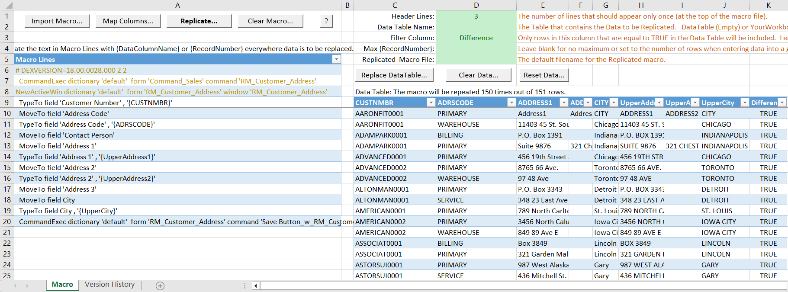
Replicator
Settings
Source Macro
Data – Refreshable Report

Slide 10
Create the Replicator file
Source Macro – Demo It!
Open GP and Record new macro to modify “one” record
Import the “one” macro into Replicator
Data – Refreshable Reports
Create refreshable report
Use RefreshableReportTemplate.xlsx (Download from Rnoldz.com)
In Replicator, use “Replace Data Table” to import the refreshable report
Add “Upper Case” columns to the Data Table
Map Columns in Macro to Data Table
Settings
Set Header Lines and Filter Column

Slide 11
Source Macro – Record in GP
A macro contains instructions to tell GP what to do
Open Window, Enter Data, Press Button…
From GP, “Record Macro” will record actions to the Macro file
Main Window -> Microsoft Dynamics GP -> Tools -> Macros ->
Other Windows -> Tools -> Macro
Record Alt+F8
Play Ctrl+F8 – Control your GP with a Macro
GP Macros are saved in plain text files
Note: Be consistent on the location where the macros are recorded. It makes it much easier when playing them back

Slide 12
Source Macro – Record Edit One Record
Log into GP
Type Alt+F8 to start recording a macro from the main window
Specify macro filename and location
Hint: Only one record is updated in macro, use the word “One” in the name
Open Cards -> Sales -> Addresses
Enter Customer ID and Address ID without using the lookup button
Enter data into the Address1, Address2, and City
Press the Save button
Type Alt+F8 to stop the recording

Slide 13
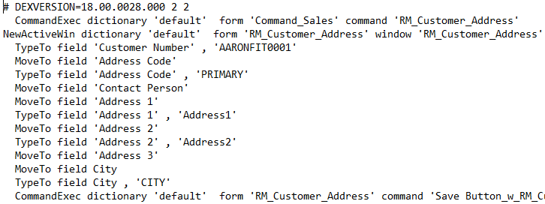
Edit One Record in Notepad

Slide 14
Edit One Record in Notepad++
Open Customer Address Window
Enter Customer ID
Enter Address ID
Enter Address 1
Enter Address 2
Enter City
Save

Slide 15
Source Macro – Edit One Record
Examine Macro in Notepad++
Link to download at Rnoldz.com
Import the GP Macro.xml language file into Notepad++
This only needs to be done once
Download from Rnoldz.com
Language Menu -> User Defined Language -> Open User Defined Language folder…
Copy “GP Macro.xml” to this folder and Restart Notepad++
Associate .mac file to “open with“ Notepad++
This only needs to be done once
Import macro into Replicator
Download from Rnoldz.com

Slide 16
Creating the Replicator file
Source Macro
Open GP and Record new macro to modify “one” record
Import the “one” macro into Replicator
Data – Refreshable Reports – Demo It!
Create refreshable report
Get RefreshableReportTemplate.xlsx and update (Download from Rnoldz.com)
In Replicator, use “Replace Data Table…” to import the refreshable report
Add “Upper Case” columns to the Data Table
Map Columns in Macro to Data Table
Settings
Set Header Lines and Filter Column

Slide 17
Data – Refreshable Reports
Configure RefreshableReportTemplate.xls
This only needs to be done once
Download from Rnoldz.com
The spreadsheet contains four worksheets for zero to three parameters
Update all four Queries & Connections under the Data Tab
Right click and select “Properties…” on each of the four Connections
Click on the Definition Tab to update the Connection String
DRIVER=SQL Server; SERVER=GP; UID=YourUser; Trusted_Connection=Yes; APP=Microsoft Office 2016; WSID=YourComputer; DATABASE=TWO
Change SERVER= your DB server’s name – GP is a great DNS entry the IT Folks should setup!
Change DATABASE= your database’s name
Save spreadsheet

Slide 18
Data – Connect to Database
Create new Refreshable Report
Open the newly configured RefreshableReportTemplate.xls
Right click on the appropriate tap and select “Move or Copy…”
Select “(new workbook)” in the “To book:”
Check “Create a Copy” and then press the “OK” button
In the Connection Properties, set:
Connection name: _ja_RM00102SelectAll
Command Text: EXEC _ja_RM00102SelectAll
Close RefreshableReportTemplate.xls
In Replicator.xlsx, click “Replace Data Table…” and highlight new worksheet
Press the “Replace Table” button to import the refreshable report
Close the new worksheet – no need to save

Slide 19
Data – Add Upper Case Columns
Add UAddress1, UAddress2, UCity, and Update columns
Add these formulas to the new address columns
=UPPER(ADDRESS1)
=UPPER(ADDRESS2)
=UPPER(CITY)
Add formula to know when the address needs to be updated
=NOT(AND( EXACT([@ADDRESS1],[@UADDRESS1]),
EXACT([@ADDRESS2],[@UADDRESS2]),
EXACT([@CITY],[@UCITY])))
Tables Rock! Notice how the formulas are auto-magically copied to every line in the table

Slide 20
Data – Map Columns
Map columns in the Data Table to fields in the “Macro Lines”
In Replicator, press the “Map Columns…” button
In the Map Columns and Prepare Macro dialog
Press the “Find Next” button to highlight AARONFIT0001
This is the CUSTNMBR, so double click in CUSTNMBR in the Data Columns
Replace all fields in the macro with the corresponding Data Column
Use CUSTNMBR, ADRSCODE, UADDRESS1, UADDRESS2, and UCITY for the fields

Slide 21
Create the Replicator file
Source Macro
Open GP and Record new macro to modify “one” record
Import the “one” macro into Replicator
Data – Refreshable Reports
Create refreshable report
Use RefreshableReportTemplate.xlsx (Download from Rnoldz.com)
In Replicator, use “Replace Data Table” to import the refreshable report
Add “Upper Case” columns to the Data Table
Map Columns in Macro to Data Table
Settings
Set Header Lines and Filter Column

Slide 22
Settings
Three Header Lines
DEXVERSION is commented out and just shows GP Version
The last two lines tells GP to open Customer Address Maintenance
These three lines should be in the Replicated macro file only one time
Set the Header Lines (Cell D1) in Replicator to 3
The Update column
Has a value of TRUE for every row that needs to be updated
Set the Filter Column (Cell D3) in Replicator to “Update” from the list
Demo It!

Slide 23
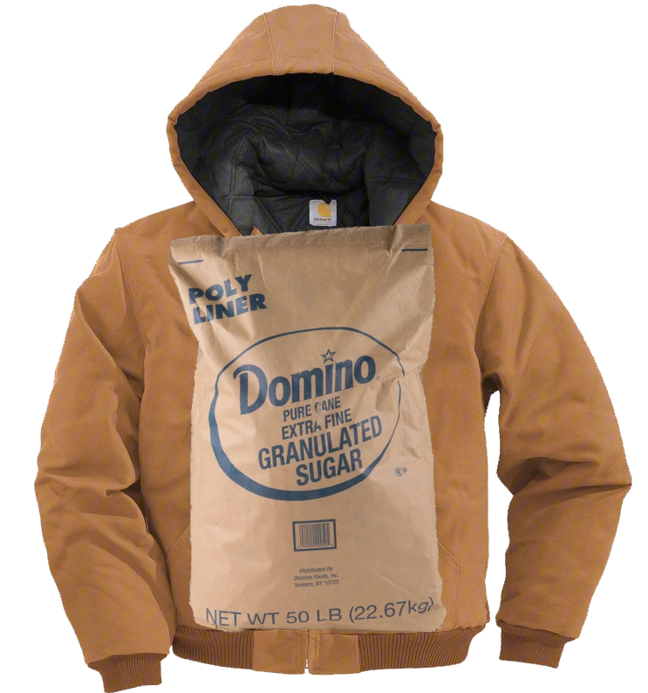
Nerd Alert – Getting into the Details
Dig
Deeper
Get into the Weeds
Dive
Deeper

Slide 24
Refreshable - _ja_RM00102SelectAll
What is this _ja_RM00102SelectAll?
It is a Stored Procedure that lives in the GP Database
It contains a SQL query to return Customer Addresses
A VERY stripped-down version of the CustomerAddress view
Uses Active Directory Security (with RefreshableReportTemplate.xls)
It SELECTs data only from RM00102 – Customer Addresses Table
It only returns the columns needed for this task
The CustomerAddress View return 113 columns from 15 tables
_ja_RM00102SelectAll return 5 columns and from 1 table
The AccountTransactions view returns 121 columns from 35 tables
Demo It!

Slide 25
Fun with SQL
SQL – Structured Query Language
Allows creation, updates, deletes, and reporting on databases and data
We will focus on reporting by using SELECT statements
We need a query to bring back the Customer Addresses
With over 2,000 tables in GP, where does one start?
Victoria Yudin’s (VictoriaYudin.com) is a GREAT resource
Table Definitions
Sample Queries
Much More
Find SmartList in GP that shows the needed data and look at the SQL
See what tables are referenced and how they are joined
Notice how GP’s view include everything AND the kitchen sink

Slide 26
CustomerAddress View
Find the CustomerAddress View in SSMS
In the Object Explorer, Open Databases -> The company database -> Views
Find the View that matches the SmartList’s name (without spaces)
Click on the first view in the tree, then start typing dbo.CustomerAddress
Use the built in Filtering
Right Click on View -> Filter -> Filter Setting
Enter CustomerAddress in the “Name” value
Press OK
Right click on the View Script View as -> Create To -> New Query Window
Examine the query SSMS (SQL Server Management Studio)
Cry at the one lllloooonnnnggg SQL statement
Wipe your tears… we can fix it

Slide 27
Fun with SQL – Formatting GP Queries
Every GP supplied View and Stored Proc is one long line of text
CustomerAddress View is 10,092 characters long – 156 lines formatted
AccountTransaction View is 36,128 characters long – 395 lines formatted
PoorSQL.com – Free website and tool to format queries
Personal preference - check the “Trailing Commas” option on poorsql.com
Copy select part of the query to the “Input SQL” tab on poorsql.com
Copy query from “Formatted SQL” back into SSMS
I have not been able to get the SSMS / Visual Studio plugin from PoorSql.com to work ☹

Slide 28
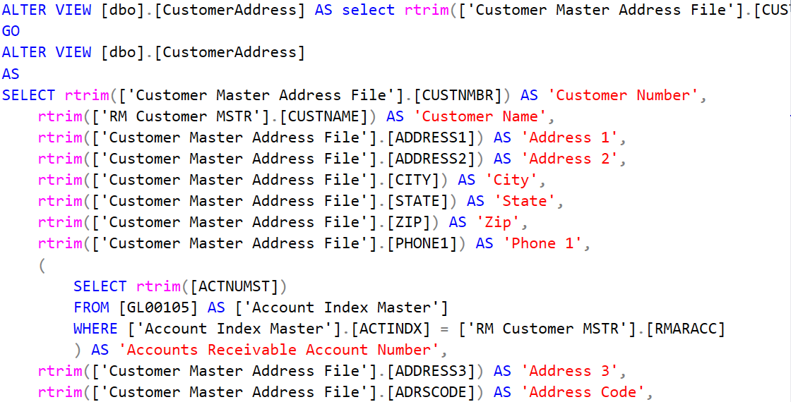
Fun with SQL – PoorSQL.com
Top Line-The original view. Everything else-Formatted by PoorSQL

Slide 29
SQL Query formatting
Don’t alias the column or table names
The word OUTER is not required
Drillbacks work great with the HYPERLINK function in Excel

Slide 30
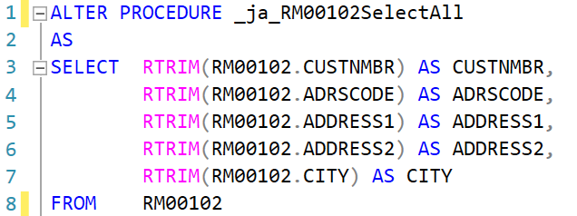
_ja_RM00102SelectAll Contents
ALTER making changes
CREATE create the stored proc
AS the contents of the stored proc
SELECT return this column
RTRIM remove trailing spaces
AS give the column a name
FROM get the data from here
Note: Do not RTRIM Numbers or Dates
What’s in a Name?
Prefix with “_” so it appears at the top in SSMS
Contains “ja” (or company initials) so we know the owner
Contains main table in the name – RM00102
Contains the action this stored procedure performs – Select All

Slide 31
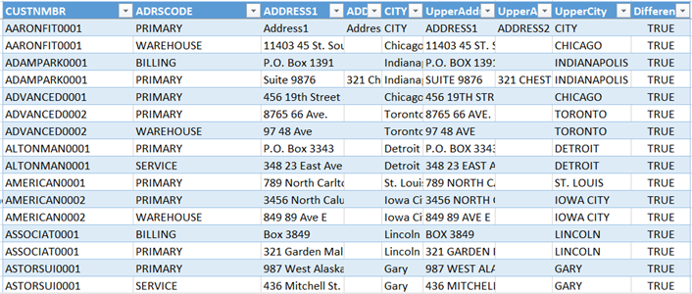
Getting Data from SQL - Security
Refresh Data Request
Get Windows User
Can they (the user or a group they belong to):
Log into the SQL Server?
Access the Database?
Execute the Stored Procedure?
Return Data
Run the query
Return the results
Refresh
Data
Request
Return
Data
Database

Slide 32
SQL Security
There is security/authentication on all objects in SQL
Windows Authentication – The user is in Active Directory (AD)
SQL Server Authentication – The user defined in SQL
GP Users are SQL Server authentication
The GP encrypts the user’s password so it can’t be used outside of GP
Security should be granted to AD groups only, never to users
AD Groups should be setup for different roles and permissions
Accounting, Inventory, HR…
View, Manager, Admin…
Multiple AD groups can be added to one Stored Procedure
Add/Remove a user to AD groups to add/remove access to DB items

Slide 33
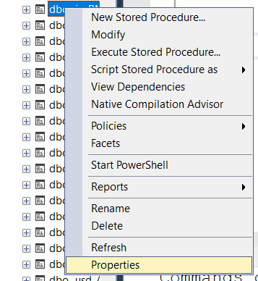
_ja_RM00102SelectAll Permissions
Add the permissions as soon as an object is created
Create the Stored Procedure (or View or Function)
Refresh the list of Stored Procedures
Right click on the new item and select Properties

Slide 34
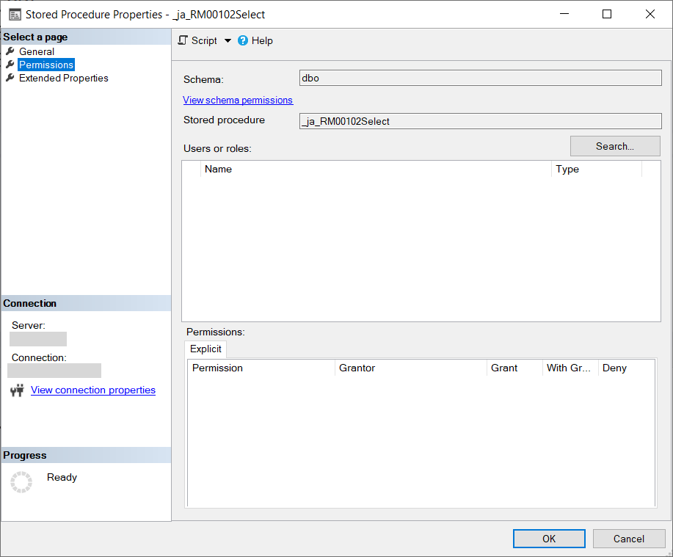
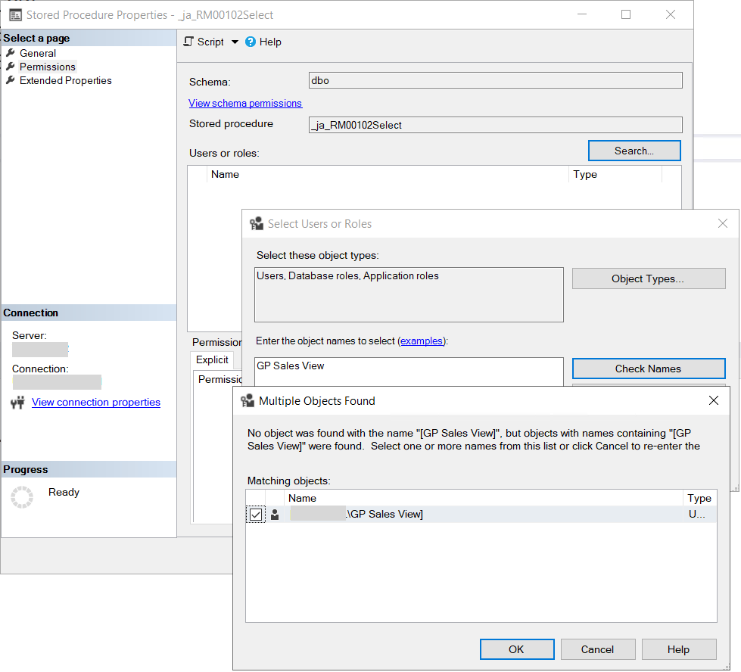
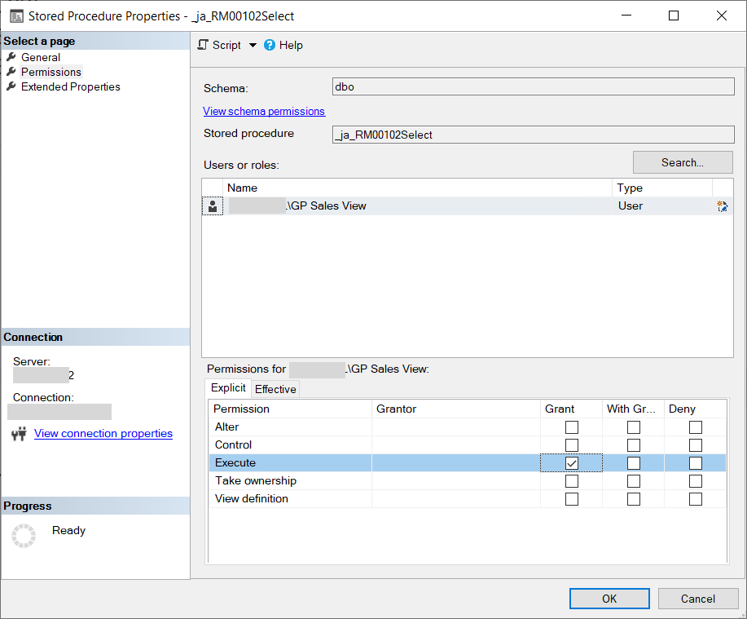
_ja_RM00102SelectAll Permissions
Press Search and enter the AD Group Name in the “Enter the object names to select” and press the “Check Names” button
Highlight the AD Group Name and Check the Grant Box for Execute
The AD Group now has permissions to use the Stored Procedure
The users in the AD Group may have to log off and back on before they can access the Database Object

Slide 35
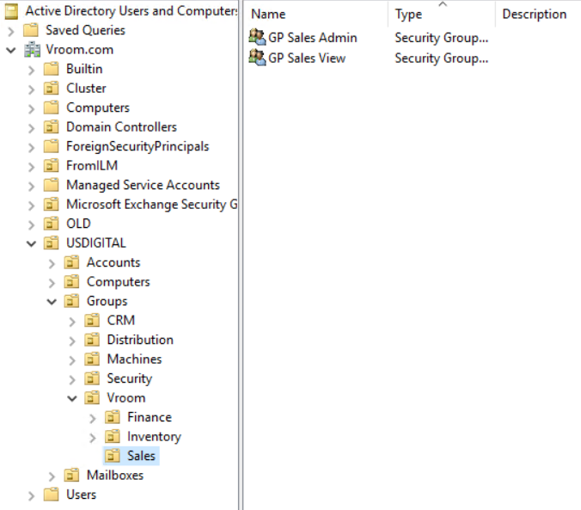
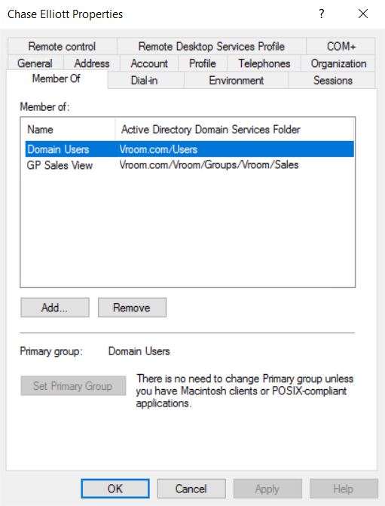
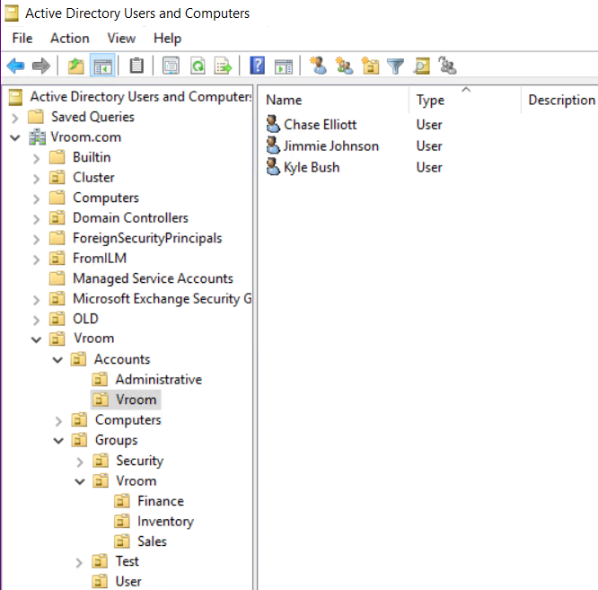
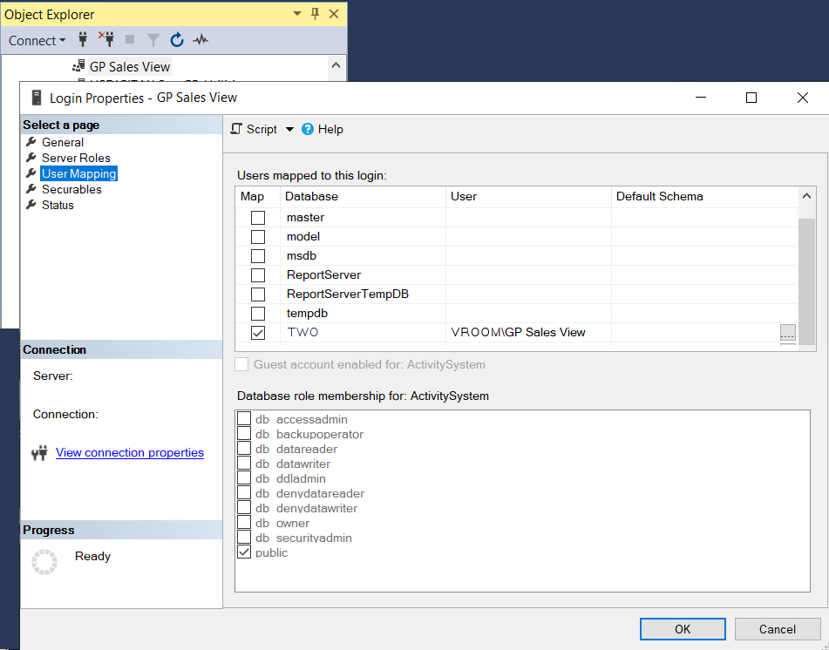
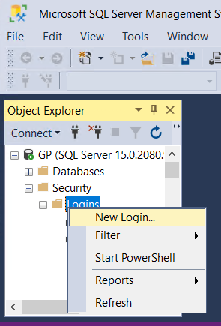
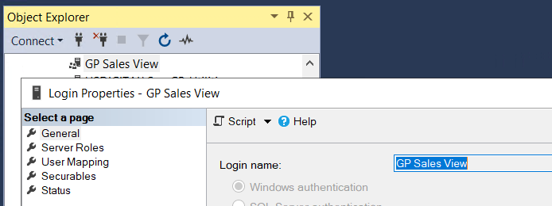
GP Sales View – Stuff for the IT Folks
How did Active Directory Group “GP Sales View” get into SQL?
From Domain Controller
Create Active Directory Groups
Create Active Directory Users
Add User to Groups
Give the AD Group access to SQL
Create a New Login in SQL Security
Enter the AD Group name
Assign Database(s) to this Login
The Group now has access to SQL

Slide 36
Refreshable Recap
Create Group: Some Group to AD
Performed by IT
Add Users to Group: Users
Add Group: Some Group to DB
Performed by You, DBA or IT
Give Group Access to DB
Create StoredProc
Performed by You or DBA
Execute Privileges: Some Group
Command Text: EXEC StoredProc
Performed by You
Excel Refreshable

Slide 37
Bonus
Excel Refreshable Reports and Parameters
Stored procedures can have parameters
The parameters can be used in the WHERE clause for filtering
RefreshableReportTemplate allows for zero to three parameters
Task: Create a new Refreshable Report that is filterable by the CITY
Demo It!

Slide 38
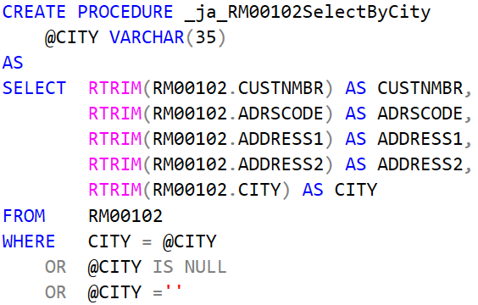
Bonus
Create _ja_RM00102SelectByCity Stored Procedure
Highlight RM00102 and hit Alt+F1 to see how large @CITY should be
Assign Permissions

Slide 39
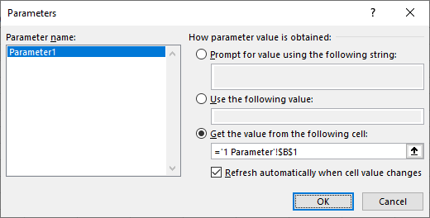
Bonus
Create new Excel file with RefreshableReportTemplate
Create a copy of the “1 Parameter” worksheet to new Workbook
Edit “Queries & Connections”
Set Command text to: “EXEC _ja_RM00102SelectByCity ?”
Click on the Parameters button
Verify Cell Reference
Verify Refresh automatically
Turn off for multiple parameters
Move Parameter cell

Slide 40
Bonus – Select Parameter from List
Excel Dynamic Array formulas to Build the List of Cities
Demo It!
Set G3 =UNIQUE(Table[Column])
Formula is in the top cell
Resulting data is in top cell and cells below
If a cell below contains data, blocking Resulting data, “#SPILL!” is displayed
Set H1 =COUNTA(G3) – Returns 1 for one cell counted
Set H2 = COUNTA(G3#) – Returns 64 for each item in the Dynamic Array
The trailing “#” tells Excel to at the entire array the cell returns
Set G3 =SORT(UNIQUE(Table[Column]))
4. This list changes as the filter applied to the query

Slide 41
Bonus – Select Parameter from List
Build Static List of Cities
Click on G3 and hit Ctrl+A to highlight list of cities
Copy list of Cities to the clipboard
Paste Values to Cell I3
Name range as “Cities”
Click on Data->Data Validation and Allow = “List”
Set Source: =Cities
If new cities are added, use above steps and Name Manager to reset the Cities range to include the new cities

Slide 42
Wrapping It Up
GP Macros – Things to watch out for
There is NO UNDO when playing back a macro!
Run the macro in a test copy of your database
After hitting “Save” in GP, make sure the cursor goes when you expect. On some GP windows, a MoveTo needs to be added
Use the Filter column to only replicate 2 – 3 records when starting
Don’t computer while the macro is running!
User Preferences/Window Command Display – Action Pane vs Menu Bar - recorded macros are not interchagable
Did I mention that there is NO UNDO and you should Test?

Slide 43
Resources
Rnoldz.com – Things you can download from my website
Pedal to the Metal.pptx
Replicator.xlsm
GP Macro.xml
Notepad++ (link to https://notepad-plus-plus.org/downloads/)
RefreshableReportTemplate.xlsx
QueryStringFinder.xlsm
VictoriaYudin.com – Tons of GP Queries and Database Information
Remember: Right click and select “Save link as…” when downloading each file. “Unblock” each downloaded file.

Slide 44
Thank you for Attending!
Questions/Comment?
John Arnold
US Digital
John_P_Arnold@hotmail.com
Please review this session!

